Slide 1

Setting up the Flask Environment

Slide 2
Installing Flask and Environment Setup

Slide 3
Installation of Flask
1. Install Python
URL: Download Python
Installation Steps:
  Go to the above link and download the latest version of Python for your operating system.
  Run the installer and make sure to check the box that says "Add Python to PATH" during installation.
  Verify the installation by opening a terminal or command prompt and running
  python –version
2. Download get-pip.py
First, download the get-pip.py script from the official Python website or directly from the following URL: Download get-pip.py
Save the file to a location on your computer, such as your desktop or a specific folder.
Run get-pip.py Script
Open a terminal or command prompt for navigating the folder and run the command python get-pip.py
pip --version

Slide 4
.\venv\Scripts\activate
Installation of Flask
3. Install Virtualenv (for managing Python environments)
URL: Virtualenv Documentation
Installation Steps:
  Once Python is installed, you can install virtualenv and create project folder by running the following command
  pip install virtualenv
  mkdir flask_project
  cd flask_project
  virtualenv venv
  Activate the virtual environment
  .\venv\Scripts\activate
4. Install Flask
Install Flask in virtual environment
pip install flask
flask --version
5. Install VS Code
Download and Install: Go to the VS Code Official Page and download VS Code.
Install Python Extension: Open VS Code, go to extensions (Ctrl + Shift + X) and install python extension

Slide 5
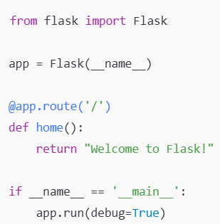
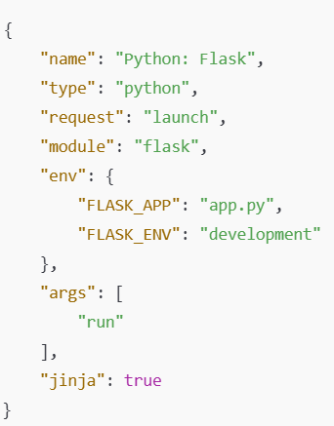
Installation of Flask
6. Setup your flask project
Open the project folder flask_project in VS Code
File → Open Folder → Select flask_project
Select Python Interpreter (Ctrl + Shift + P ) and type Python: Select Interpreter and select virtual environment venv
Create app.py and add the following code and run flask app (python app.py)
7. Debug Flask in VS Code
Create a Debug Configuration:Click on Ctrl + Shift + D
Click the Run and Debug icon in the left sidebar.
Click Create a launch.json file.
Select Python.
Start Debugging: Press F5

Slide 6
Understanding Flask Structure and Key Files

Slide 7
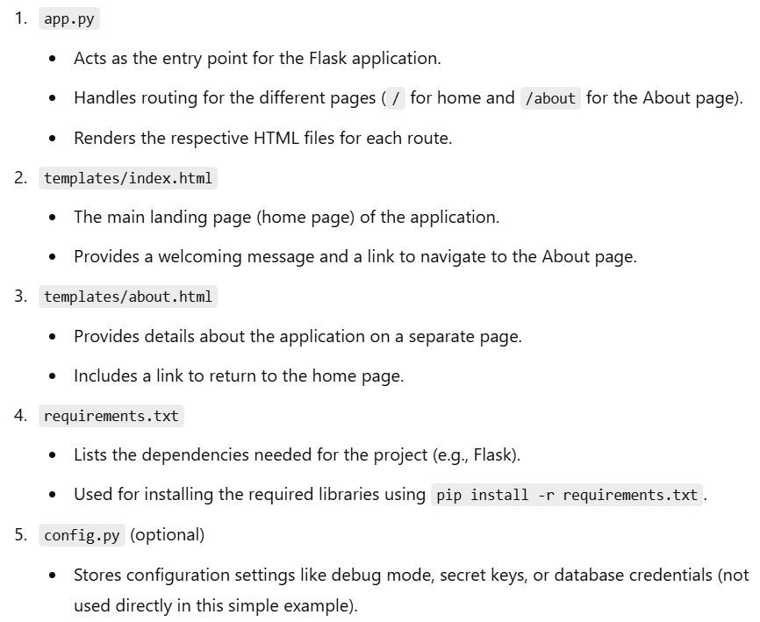
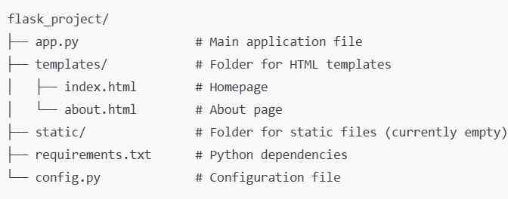
Flask Structure

Slide 8
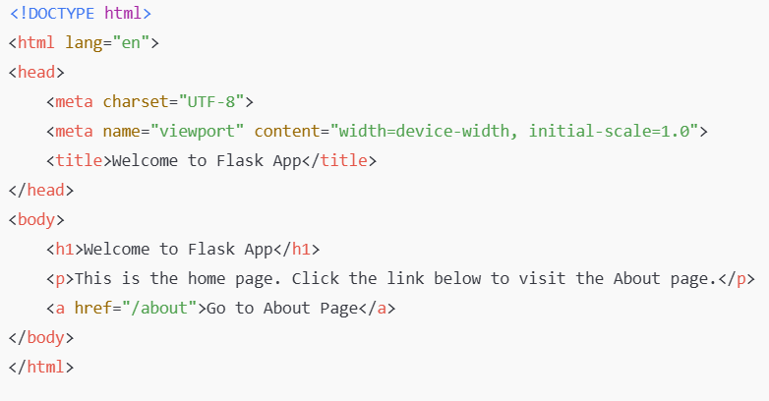
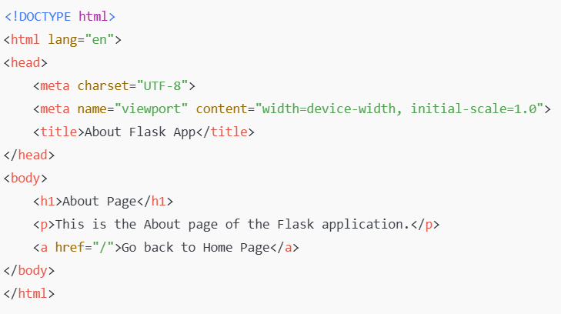
Flask Structure
1. templates/index.html
Simple HTML file for the homepage:
2. templates/about.html
Simple HTML file for the About page:

Slide 9
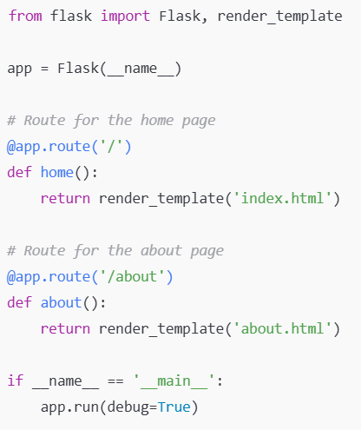
Flask Structure
app.py

Slide 10
Thank You!

